Slide 1
SVA and Coverage Introduction
Jinfeng.Huang
2017/11/23

Slide 2
Outline
SVA Introduction
SVA Syntax
Examples
SVA Checker Library (VCS)
Introduction Coverage
Code Coverage
Function Coverage

Slide 3
SVA Introduction

Slide 4
SVA Introduction
IEEE Std. 1800 – 2005 (2009) SystemVerilog
Hardware Verification Language (HVL)
Dynamic Types
Class (Object Orient Program)
Random Constraint
Interprocess synchronization and Communication
Assertion
SVA (Systemverilog Assertion)
PSL (Property Specification Assertion)
OVA (OpenVera Assertion)
VHDL provide assert construct
Coverage

Slide 5
SVA Introduction
How to Check Design Spec is not violated
b shall be high after a is high
b shall be active when a is high at 3~5 clocks
a
b
3~5clk

Slide 6
Verilog VS SVA
Verilog
SVA
always @(posedge a)
begin
repeat (3) @(posedge clk);
fork: a_to_b
begin
@(posedge b)
disable a_to_b;
end
begin
repeat (2) @(posedge clk);
disable a_to_b;
end
join
end
a2b_chk :
assert property
( @(posedge clk) $rose(a) |-> ##[3:5] $rose(b) )
$info (“a2b_chk PASS”)
else
$error(“a2b_chk Fail”);;
Assertion Control System Task
$fatal
$error
$warning
$info

Slide 7
SVA Instantiation
Example1: In-line
Example2: Bind
module DUT(
input …,
);
…
…
assert …;
assert …;
assert …;
endmodule
module DUT(
input …,
);
…
…
endmodule
module Test_sva1(
input …,
);
assert …;
assert …;
endmodule
bind DUT Test_sva1 name_xxx(…);
bind Top.U_DUT Test_sva1 name_xxx(…);
Hierarchy:
Top (Top)
U_DUT (DUT)
name_xxx (Test_sva1)
Reusable => SVA Checker library

Slide 8
VCS Simulation Options
VCS Compile Option
-sverilog : systemverilog syntax check
-assert report=xxx.log : generate log for sva
-assert finish_maxfail=N : terminate simulation if fail = N
-assert disable_file, -assert disable, ….
Simulation Log
Info: "test_sva.v", 4: top.U_TEST_SVA.a2b_chk: at time 90 ns
a2b_chk Pass
"test_sva.v", 4: top.U_TEST_SVA.a2b_chk: started at 130ns failed at 230ns
Offending '$rose(b)'
Error: "test_sva.v", 4: top.U_TEST_SVA.a2b_chk: at time 230 ns
a2b_chk Fail
Fail reason

Slide 9
SVA Syntax

Slide 10
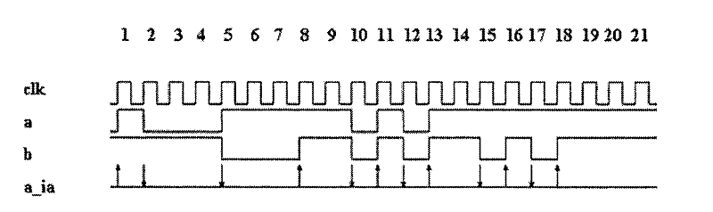
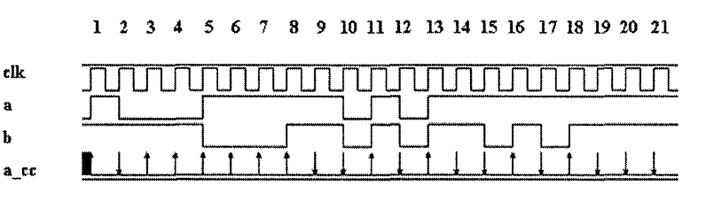
SVA Types
Immediate Assertion
Based on simulation event
Concurrent Assertion
Based on clock cycles
assert (expression) [ pass_statement else fail_statement ] ;
always @ (*)
assert (a &&b);
assert property (property_spec) [ pass_statement else fail_statement ] ;
assert property ( @(posedge clk) (a &&b) );

Slide 11
Concurrent Assertion
name : assert property (sequence_or_property_or_expression)
<message>;
else
<message>;
sequence name_s1;
<test expression>;
endsequence
property name_p1;
<test expression>;
endproperty

Slide 12
Sequence and Property Declaration
sequence identifier [ argument_list ];
[clock event ] sequence_expr [ seq_op sequence_expr];
endsequence
sequence s1;
a ##1 b ##1 c;
endsequence
sequence s2;
( d ##1 e)
endsequence
sequence s3;
@(posedge clk) s1 ##1 s2
endsequence
sequence s4(a,b);
@(posedge clk) a ##1 b
endsequence
property identifier [ argument_list ];
[clock_expr] [disable clause] property_expr;
endproperty
property p1;
a ##1 b ##1 c;
endsequence
property p2;
@(posedge clk) s1;
endsequence
property p3;
@(posedge clk) disable iff (reset ) s1;
endsequence
property p3;
@(posedge clk) s1 |-> s2 ;
endsequence
property p4(a,b,c,d);
@(posedge clk) s4(a,b) ##1 s4(c,d);
endsequence
assert property ( @(posedge clk) a ##1 b ##1 c );
assert property ( @(posedge clk ) s1 );
assert property ( s3);
assert property ( p2);
assert property ( @(posedge clk) p1 ) ;

Slide 13
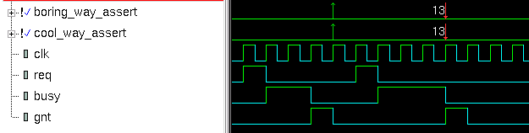
Sequence Operations
[*n | n:m | n:$ ] : consecutive repetition
sequence boring_way_seq;
req ##1 busy ##1 busy ##1 gnt;
endsequence
property boring_way_prop;
@ (posedge clk) req |-> boring_way_seq;
endproperty property
sequence cool_way_seq;
req ##1 busy [*2] ##1 gnt;
endsequence
cool_way_prop;
@ (posedge clk) req |-> cool_way_seq; endproperty
Consecutive repetition specifies finitely many iterative matches of the
operand sequence, with a delay of one clock tick from the end of one match to the beginning of the
next. The overall repetition sequence matches at the end of the last iterative match of the operand.

Slide 14
Sequence Operations
a[*n:m] equal a[*n] or a[*n+1] or . . . or a[*m]
a[*0] is empty sequence
(empty ##0 seq) does not result in match
(seq ##0 empty) does not result in match
(empty ##n seq) equal (##(n-1) seq) where n>0
(seq ##n empty) equal (seq ##(n-1) `true) where n > 0
b ##1 a[*0:2] ##2 c ➔ (b ##2 c ) or (b ##1 a ##2 c) or (b ##1 a ## 1 a ##2 c)
b ##1 a[*0] ##2 c ➔ b ##1 empty ##2 c ➔ b ##0 `true ##2 c ➔ b ##2 c
b ##1 a[*1] ##2 c ➔ b ##1 a ##2 c
b ##1 a[*2] ##2 c ➔ b ##1 a ##1 a ##2 c
B | 1
A | -
C | 1
B | 1 | - | - | -
A | - | 1 | - | -
C | - | - | - | 1
B | 1 | - | - | - | -
A | - | 1 | 1 | - | -
C | - | - | - | - | 1

Slide 15
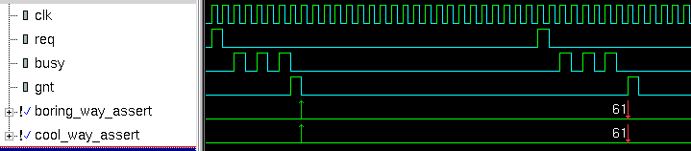
Sequence Operations
[-> n | n:m | n:$ ] : goto repetition
sequence boring_way_seq;
req ##1 ((!busy[*0:$] ##1 busy) [*3]) ##1 gnt;
endsequence
property boring_way_prop;
@ (posedge clk) req |-> boring_way_seq;
endproperty property
sequence cool_way_seq;
req ##1 (busy [->3]) ##1 gnt;
endsequence
cool_way_prop;
@ (posedge clk) req |-> cool_way_seq; endproperty
Goto repetition specifies finitely many iterative matches of the operand
boolean expression, with a delay of one or more clock ticks from one match of the operand to the
next successive match and no match of the operand strictly in between. The overall repetition
sequence matches at the last iterative match of the operand

Slide 16
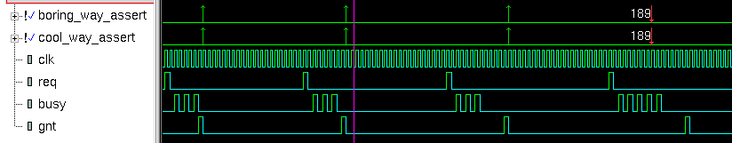
Sequence Operations
[=n |n:m | n:$ ] : non-consecutive repetition
sequence boring_way_seq;
req ##1 ((!busy[*0:$] ##1 busy) [*3]) ##1 !busy[*0:$] ##1 gnt;
endsequence
property boring_way_prop;
@ (posedge clk) req |-> boring_way_seq;
endproperty property
sequence cool_way_seq;
req ##1 (busy [=3]) ##1 gnt;
endsequence
cool_way_prop;
@ (posedge clk) req |-> cool_way_seq; endproperty
Nonconsecutive repetition specifies finitely many iterative
matches of the operand boolean expression, with a delay of one or more clock ticks from one match
of the operand to the next successive match and no match of the operand strictly in between. The
overall repetition sequence matches at or after the last iterative match of the operand, but before any
later match of the operand

Slide 17
Sequence Operations
req ##1 busy [->2:10] ##1 gnt
req ##1 ((!busy[*0:$] ##1 busy) [*2:10]) ##1 gnt
req ##1 busy [=2:10] ##1 gnt
req ##1 ((!busy [*0:$] ##1 busy) [*2:10]) ##1 !busy[*0:$] ##1 gnt
# of busy(1’b1) 2~10 are success
# of busy(1’b1) 2~10 are success

Slide 18
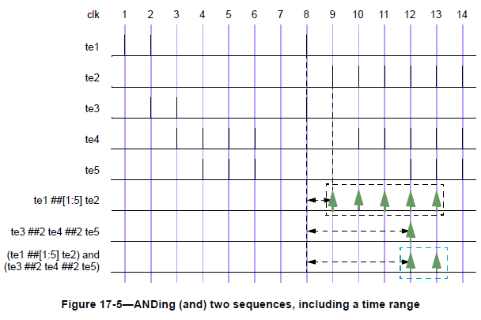
Sequence Operations
sequence_expr1 and sequence_expr2
Both sequence must occur, but the end times of the operands can be different

Slide 19
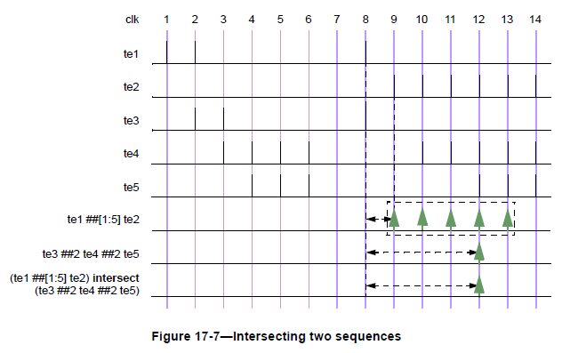
Sequence Operations
sequence_expr1 intersect sequence_expr2
Both sequences must occur, and the start and end times of the sequence expression must be the same

Slide 20
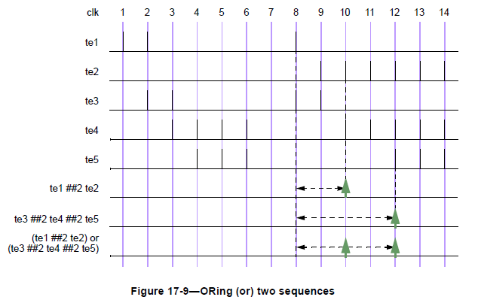
Sequence Operations
sequence_expr1 or sequence_expr2
At lease one of the sequences must occur

Slide 21
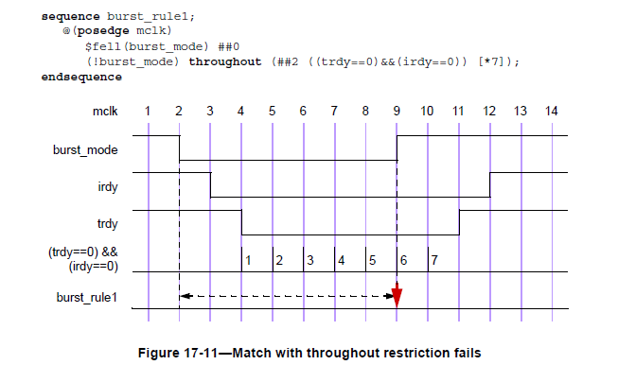
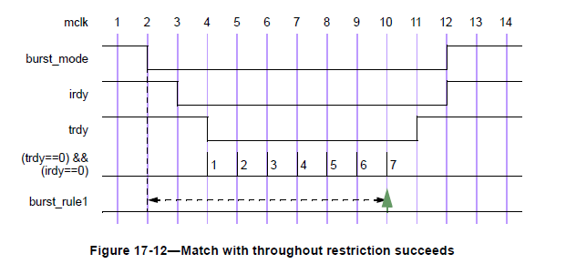
Sequence Operations
boolean_expr throughout sequence_expr
A condition must hold true for the duration of a sequence

Slide 22
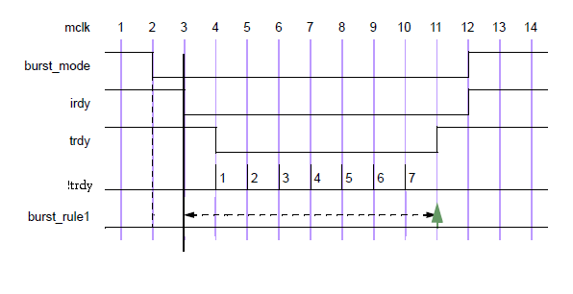
Sequence Operations
sequence_expr1 within sequence_expr2
sequence_expr1 must match at some point within the timeframe of sequence_expr2
!trdy[*7] within (($fell irdy) ##1 !irdy[*8])

Slide 23
Sequence Operations
first_match ( sequence_expr [, sequenct_match_item] )
Evaluation of one or more sequences stops when the first match is found
== >first_match

Slide 24
System Functions
$rose returns true, when LSB of expression changes to 1.
$fell returns true, when LSB of expression changes to 0.
$stable returns true, if value did not change since last clock event to current clock event.
$past returns value n clock events before.
$onehot return true if one and only one bit of the expression is high
$onehot0 return true if no more than one bit of the expression is high
$isunknown returns true if any bit of the expression is X or Z
$countones returns the number of bits in a vector that have value 1
property system_prop;
@ (posedge clk)
($rose(req) && $past(!req,1)) |=> ($rose(gnt) && $past(!gnt,1));
endproperty

Slide 25
Property Expressions
sequence_expr Implicitly transform to “first_match (sequence_expr)”
sequence_expr |-> property_expr Overlapped Implication The property must be true in the last cycle that the sequence expression is true
sequence_expr |=> property_expr Non Overlapped Implication The property must be true in the first cycle after the sequence expression is true (equivalent to “sequence_expr ##1 `true |-> property_expr” )
property_expr and property_expr Conjunction Return true if both property expressions are true
property_expr or property_expr Disjunction Return true if any property expressions is true
not property_expr Negation Returns the opposite of the value returned by the property_expr
if (expression) property_expr1 [ else property_expr2 ] If the expression is true, then peoperty_expr1 must be hold; property1 does not need to hold when expression is false (No Else) If expression is false, peoperty_expr2 must hold, if it exists (Has Else)

Slide 26
Implication
sequence_expr |-> property_expr
antecedent consequent
P “There are cell phones in the room”
Q "all cell phones in the room are turned off“ "all cell phones in the room are
If there is no cell phones in the room (P is False)
"all cell phones in the room are turned off“ (Q) is vacuous True.
P | Q | P|->Q
0 | 0 | T(Vacuous Success)
0 | 1 | T(Vacuous Success)
1 | 0 | F(Fail)
1 | 1 | T(Success)

Slide 27
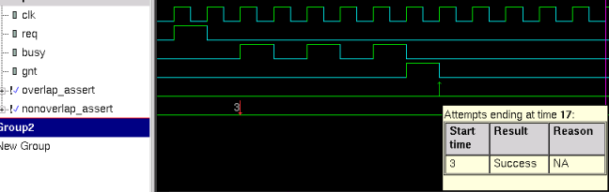
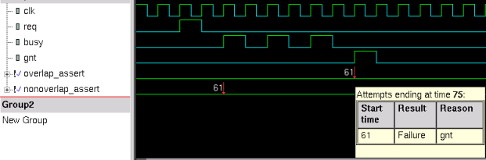
Implication
sequence implication_seq;
req ##1 (busy [->3]) ##1 gnt;
endsequence
property overlap_prop;
@ (posedge clk) req |-> implication_seq;
endproperty
property nonoverlap_prop;
@ (posedge clk) req |=> implication_seq;
endproperty
evaluation from 3 to 17

Slide 28
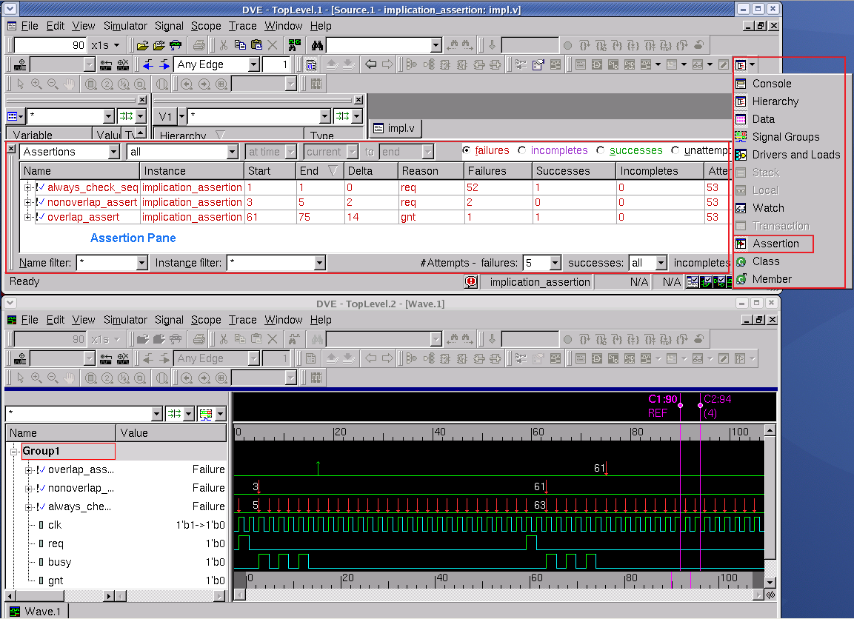
always_check_seq :
ssert property ( @(posedge clk) implication_seq );
A lot of Failures because we don’t give appropriate start time for evaluation.

Slide 29
Sequence methods
ended
To detect end point of a sequence.
Syntax : <seq>.ended
Evaluates to either TRUE or FALSE. And is available for only one clock cycle.
Does not depend on start point of sequence.
1
2
3
4
5
6
7
a
b
sequence s1; a ##[1:3] b ##1 c; endsequence
property p1;
@posedge (clk)
$rose(a) |-> ##2 p ##0 s1.ended ##1 q;
endproperty
c
s1.ended
p
q
p1

Slide 30
Sequence methods cntd…
matched
Is used for synchronization between clock domains.
Similar to “ended” method.
Only difference is that the result of sequence end point in source clock domain would be available until the first clock tick in destination clock domain.
Sequences must have clocking event.
1
2
3
sequence s1;
@(posedge fast_clk)
a ##[1:3] b ##1 c;
endsequence
property p1;
@posedge (slow_clk)
(1) |-> ##1 p ##0 s1.matched ##1 q;
endproperty
slow_clk
fast_clk
1
2
3
4
5
6
7
a
b
c
Source clock domain : fast_clk
Destination clock domain : slow_clk;
s1 is ended at 4th clock in fast_clk domain.
S1.matched is used to convey this info to slow_clk domain.
S1.matched would be true until 2nd clock in slow_clk domain. This is the first clock tick after s1 is ended.
s1.ended
s1.matched

Slide 31
disable iff
Disable the assertion during certain condition.
Expect
expect statement causes the executing process to block until the given property succeeds or fails.
assert property ( @(posedge clk)
disable iff (rst_ n) ($rose(req) |=> ##[1:3] gnt)
);
program tst;
initial begin
# 200ms;
expect( @(posedge clk) a ##1 b ##1 c ) else $error( "expect failed" );
ABC: ...
end
endprogram
integer data;
...
task automatic wait_for( integer value, output bit success );
expect( @(posedge clk) ##[1:10] data == value ) success = 1;
else success = 0;
endtask
initial begin
bit ok;
wait_for( 23, ok ); // wait for the value 23
...
end
Class method or Task
Execute one command then wait for expected response

Slide 32
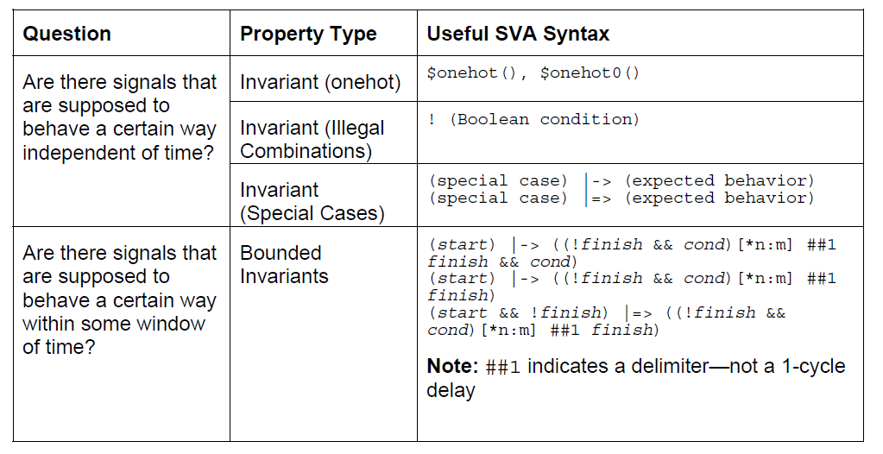
General Problem

Slide 33
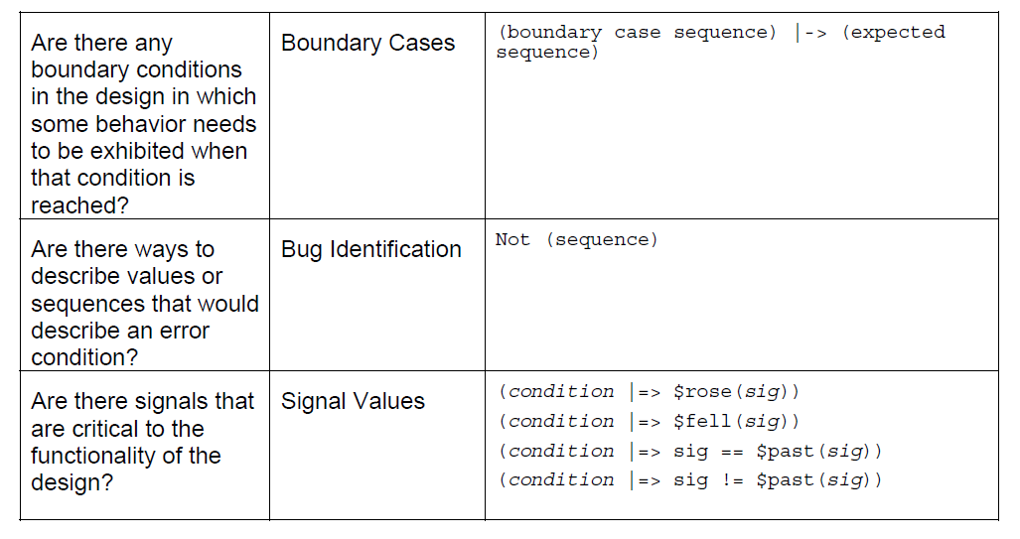
General Problem

Slide 34
SVA Checker Library
Why You Need SVA Checker Library ?
SVA is not quite intuitive, and hard to write property that meet your spec completely. (without false alarm)
Provide set of preverified common property for easy use.
Package
$VCS_HOME/package/sva
$VCS_HOME/package/sva_cg

Slide 35
SVA Checker Library
module fifo(clk, data, rd_wr, full, empty);
inputclk, rd_wr; outputfull,empty;
// Two kinds of Instation
assert_mutex check1(.rst_n(1’b1),.clk(clk),.a(full),.b(empty));
/*sv_pragma
assert_mutex check1(.rst_n(1’b1),.clk(clk),.a(full),.b(empty));
*/
endmodule
// RTLcode not shown…
endmodule
Assertion Control
vcs fifo.v tb.v -sverilog –sv_pragma +define+ASSERT_ON \
-y $(VCS_HOME)/packages/sva/ +libext+.v \
+incdir+$(VCS_HOME)/packages/sva

Slide 36
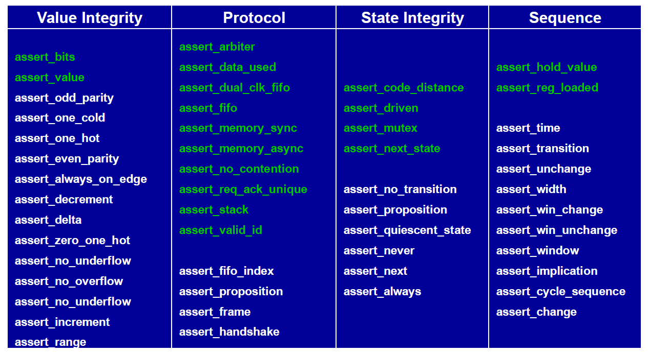
SVA Checker Library Glance
More refer to SVA Checker Library Manual
$VCS_HOME/doc/UserGuide/pdf/sva_checkerlib.pdf
$VCS_HOME/doc/UserGuide/pdf/sva_quickref.pdf
Synopsys Tutorial - SVA for Designers Tiger

Slide 37
Coverage Introduction

Slide 38
Verification Qualification
How to know the quality of verification?
Design Specification ⬄ Test Plan / Test Item
Simulation
Testbench (Pattern)
FPGA
Test Equipment
Packet Length 64~1518
Packet Type Identification
System Requirement (wire speed without packet drop)
QoS
Low Power
Packet Length 1~2048
All Recognized / Unrecognized Packet Type
Wire speed
Special Conditions for QoS
Special Conditions for Low Power
Mix Special Conditions
Packet Length 1~2048
All Packet Type
Wire speed
Special Conditions for QoS
Special Conditions for Low Power
Mixed Special Conditons

Slide 39
Verification Qualification
All listed items completed
Perfect ! Happy Ending , Are you sure @_@ ?
Tapeout Q_Q
Coverage (Qualification) Metrics
Code Coverage
Function Coverage
Packet Length 1~2048
All Packet Type
Wire speed
Special Conditions for QoS
Special Conditions for Low Power
Mixed Special Conditons
Confidence Level

Slide 40
Simulation based verification: coverage
Verification coverage estimates the quality of simulation

Slide 41
Coverage Metrics
Code Coverage
Flow Control Coverage
Lines Coverage
Condition Coverage
Value Coverage
Toggle Coverage
FSM Coverage
Functional Coverage
Testbench variable value and transition.
SV covergroup , because of stimulus is randomized that you don’t know the quality of random test.
Random test help you raise coverage in short time. But it’s not almighty.
Directed Test. Question is you still need to know what is not covered.

Slide 42
Code Coverage

Slide 43
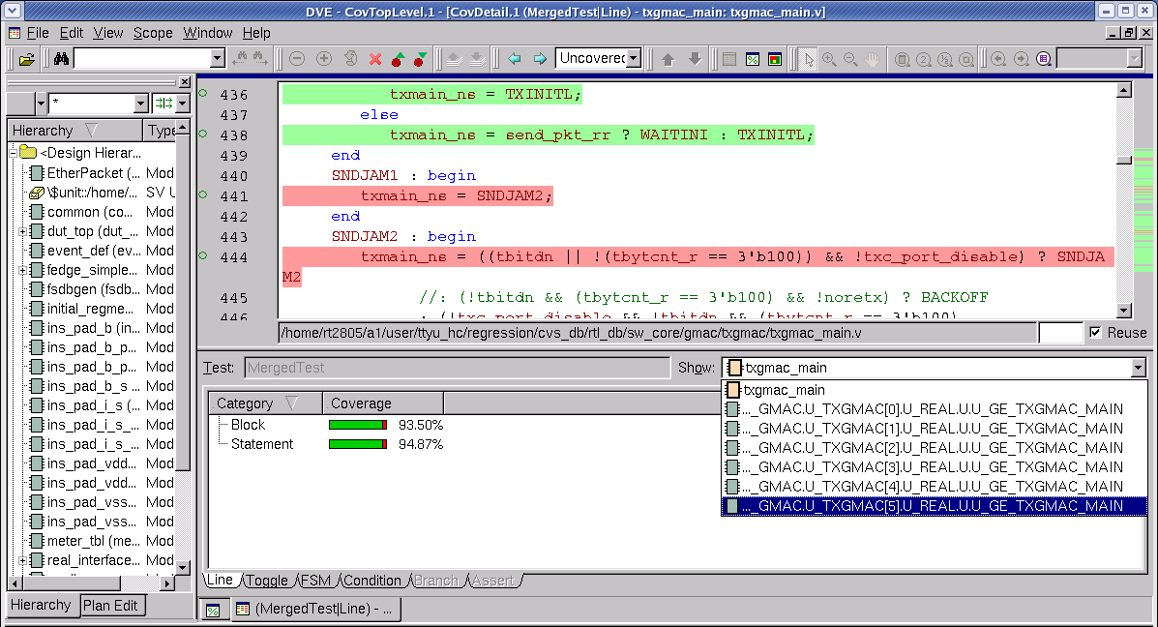
Line Coverage
Covered
Uncovered

Slide 44
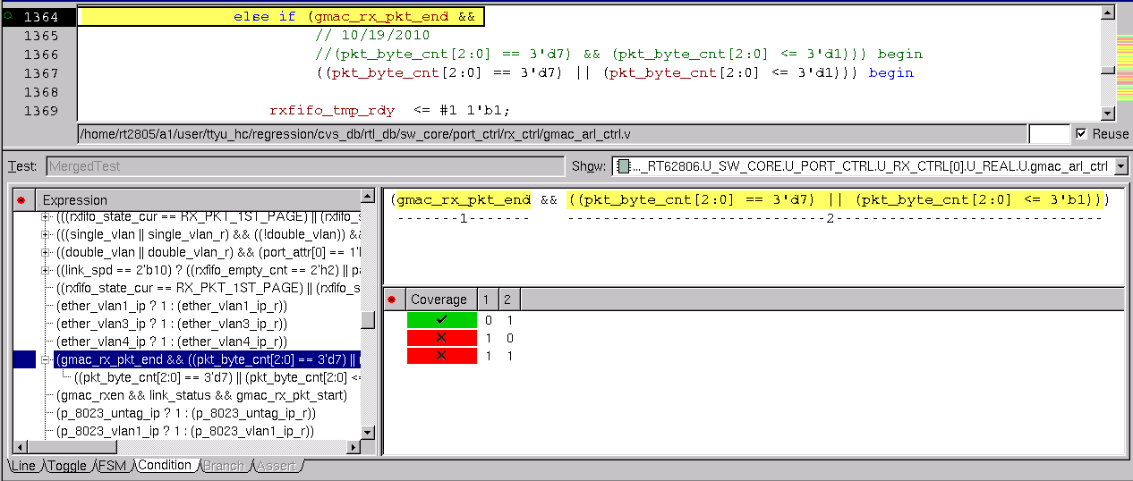
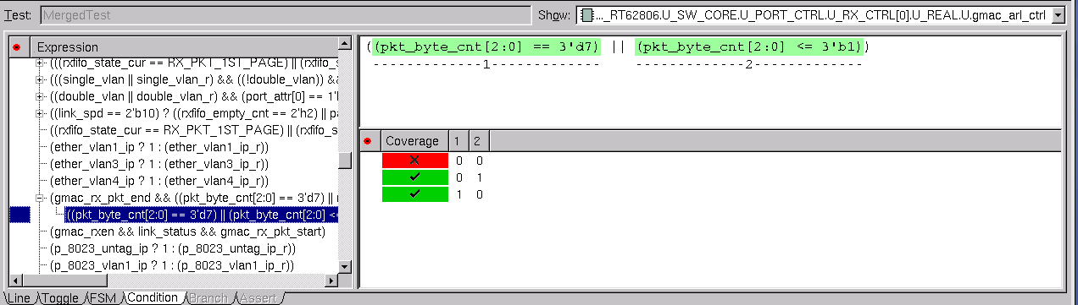
Condition Coverage

Slide 45
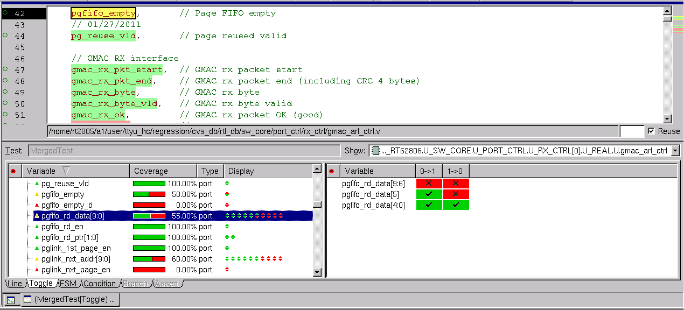
Toggle Coverage

Slide 46
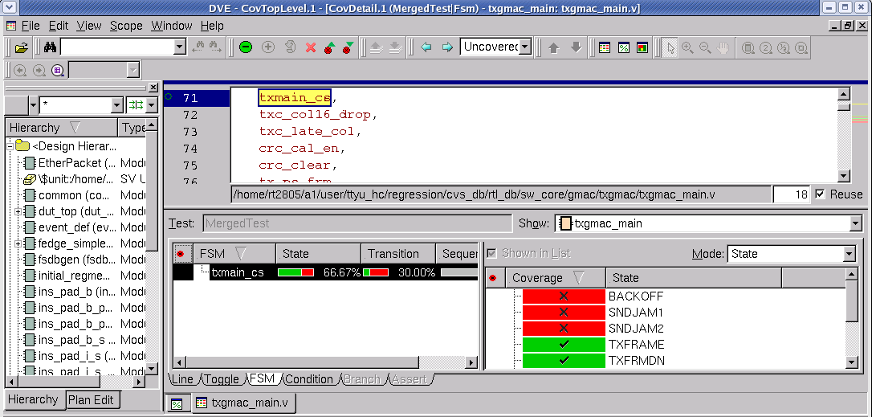
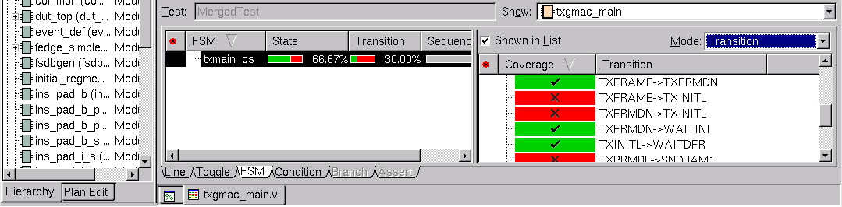
FSM Coverage
Uncovered State
Uncovered Transition

Slide 47
Function Coverage

Slide 48
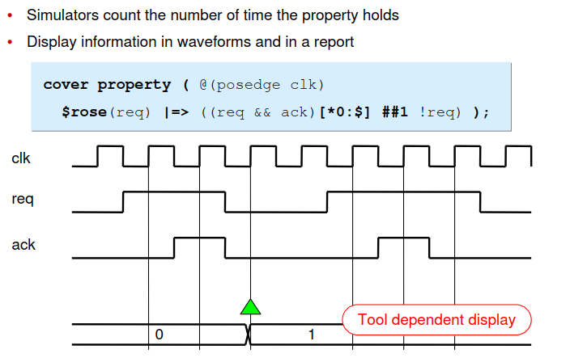
Function Coverage Type
Cover property
use SVA temporal syntax
same properties that assertions use
only be placed in structural code, not in class-based objects

Slide 49
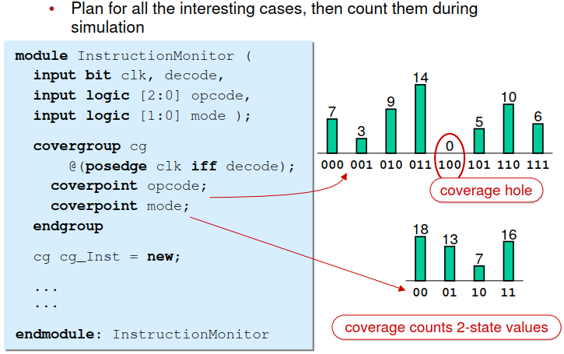
Function Coverage Type
Covergroups
record values of coverpoints
provide functional crosses of coverpoints
placed in both objects and structural code

Slide 50
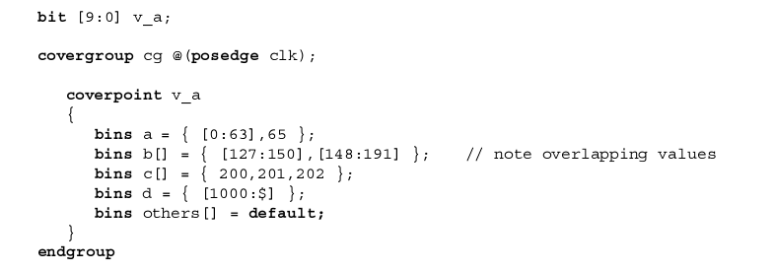
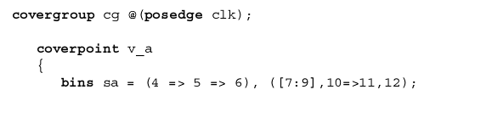


covergroup and coverpoint

Slide 51
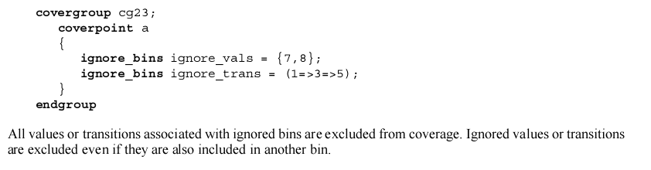
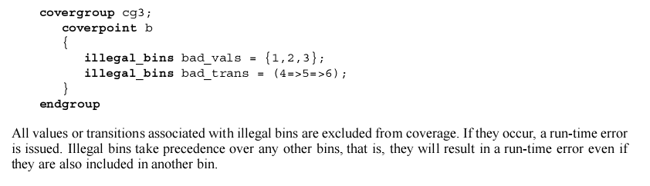
ignore and illegal bins

Slide 52
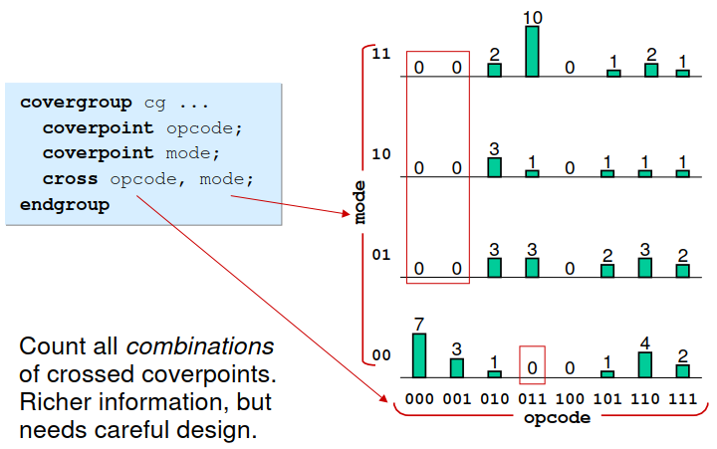
cross

Slide 53
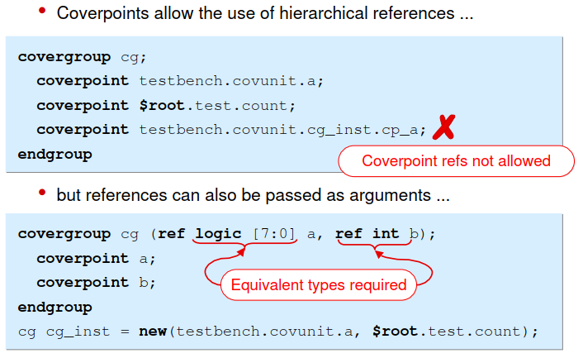
argument

Slide 54
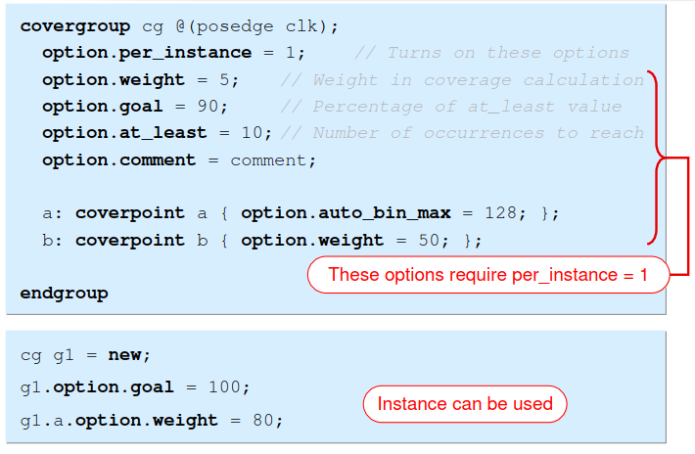
Function coverage options

Slide 55
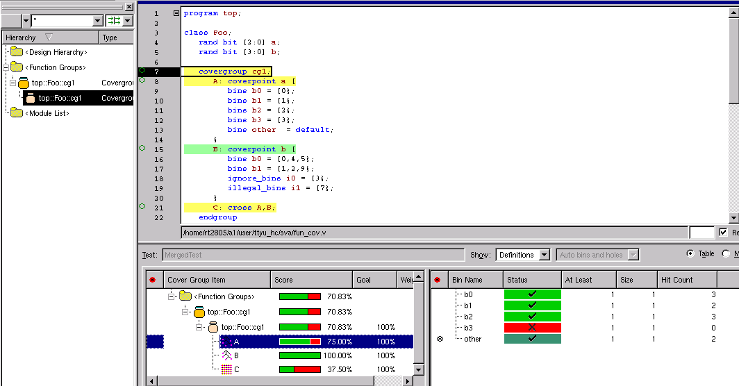
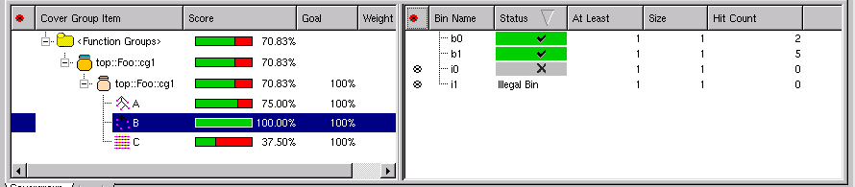
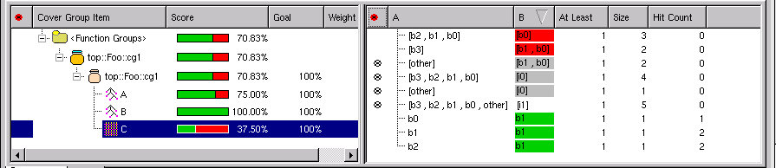
Functional Coverage

Slide 56
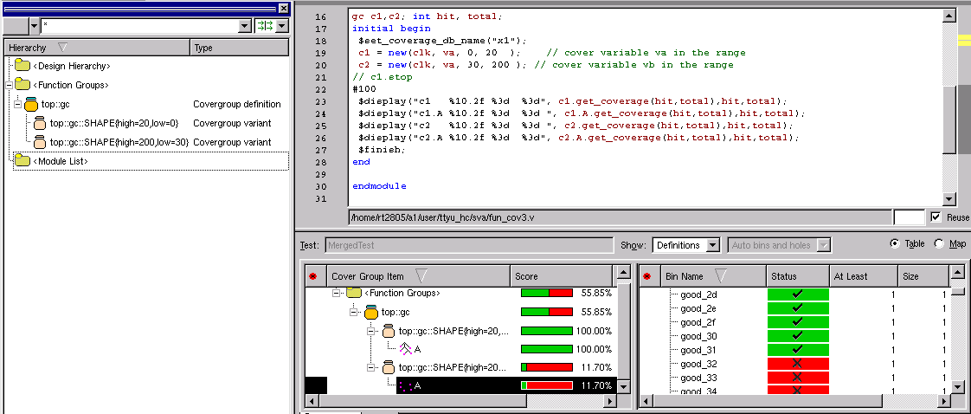
module top;
bit clk;
bit [7:0] va;
covergroup gc (ref clk, bit [7:0] ra, input int low, int high) @(posedge clk);
A: coverpoint ra // sample variable passed by reference
{
bins good[] = { [low : high] };
bins bad[] = default;
}
endgroup
gc c1,c2;
int hit, total;
always @(posedge clk) va<=va+1;
always #1 clk=~clk;
initial begin
$set_coverage_db_name("x1");
c1 = new(clk, va, 0, 20 ); // cover variable va in the range
c2 = new(clk, va, 30, 200 ); // cover variable vb in the range
// c1.stop
#100
$display("c1 %10.2f %3d %3d", c1.get_coverage(hit,total),hit,total);
$display("c1.A %10.2f %3d %3d ", c1.A.get_coverage(hit,total),hit,total);
$display("c2 %10.2f %3d %3d ", c2.get_coverage(hit,total),hit,total);
$display("c2.A %10.2f %3d %3d", c2.A.get_coverage(hit,total),hit,total);
$finish;
end
endmodule

Slide 57
Waiting for ...
Topic on TB based on SystemVerilog
Topic on SVA and Function coverage
Topic on UVM
Topic on TB based on UVM

